Slide 1
Presentation on
Aquatic FishRobo
Presented by:
1.Sagar Narkhede(17231014) 3. Ashlesha Borade(16131036)
2.Omkar Sutar (16132063) 4. Pooja Katkar(17231011)
Guided by:
Dr.N.P. Futane
Reference by:
eYantra Robotics Competition

Slide 2
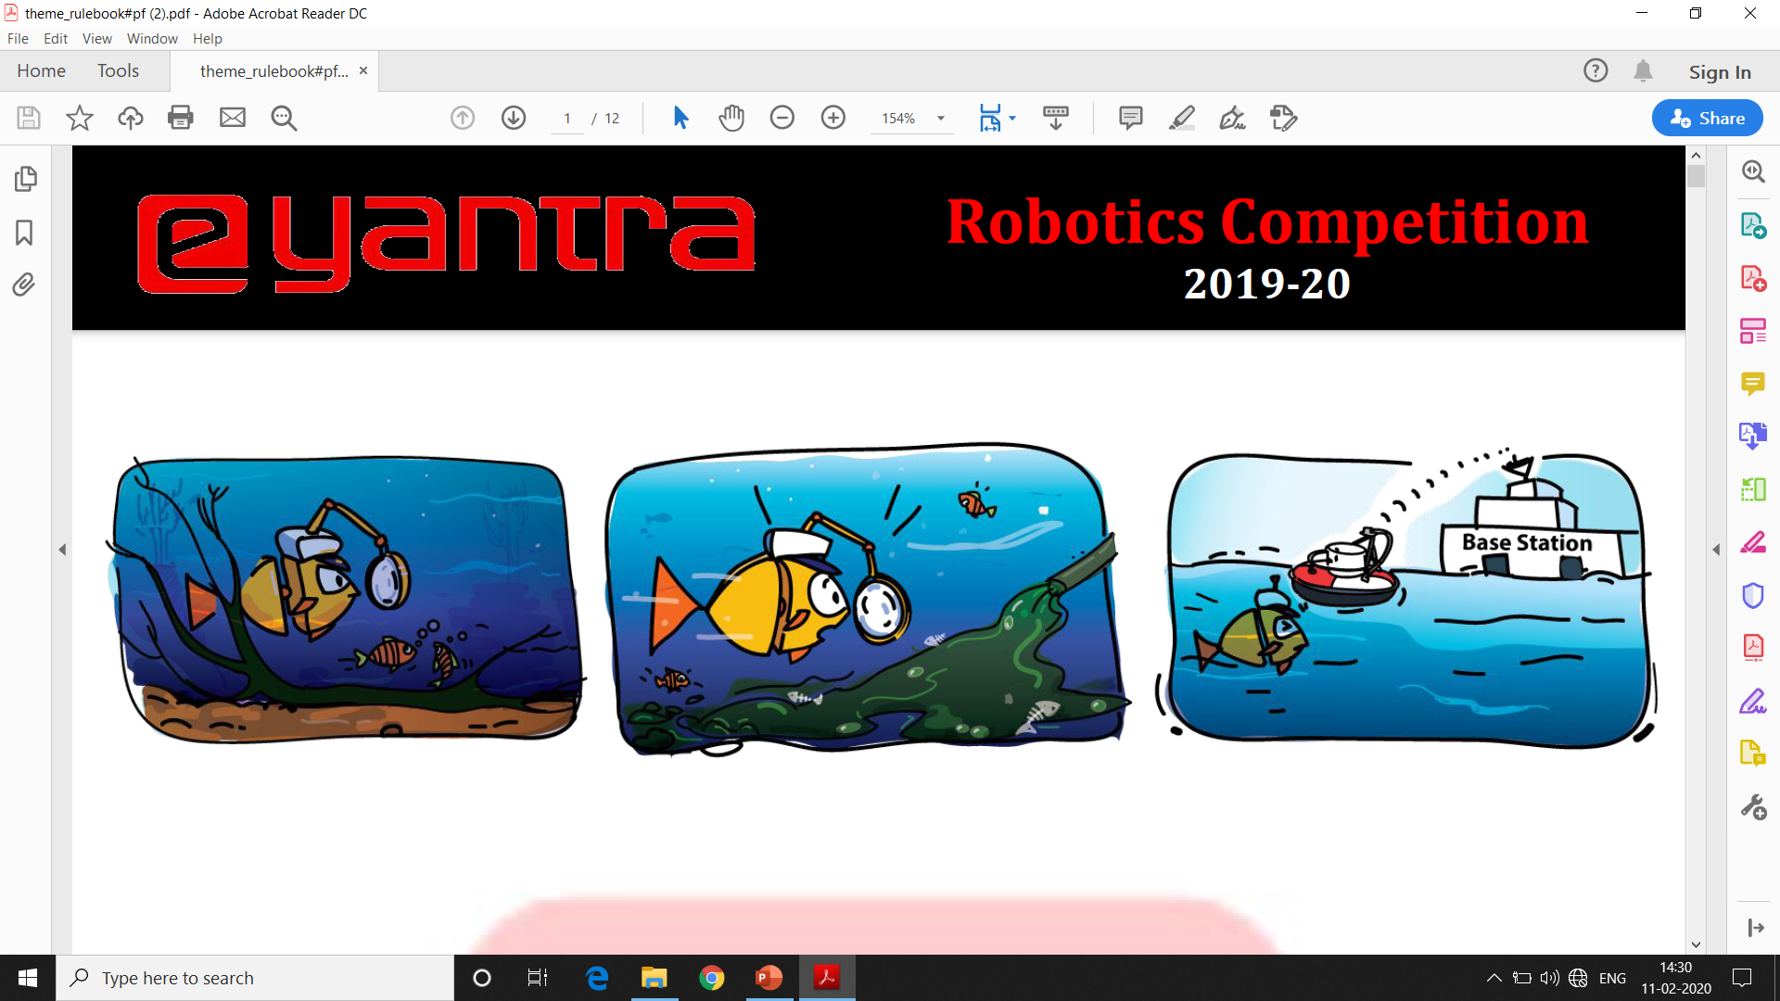
1. Introdction:
In this theme, we are designing and building a Aquatic FishRobo that bio-mimics different locomotion's of a fish. The aquatic world is populated with a diverse variety of fishes from which we took inspiration for designing our Aquatic robot. This robot replicates the natural movement of a fish’s muscles by using a number of servo actuated joints that are connected to each other. Through a coordinated movement of these joints, the fish robot can swim to propel itself forward.
In order to represent the muscle joints of a natural fish, we use servo actuators and for the fish’s body, we design brackets, that serve the following two purposes:
✓ to define the relative position and orientation between actuators and
✓ to define the profile of the fish.

Slide 3
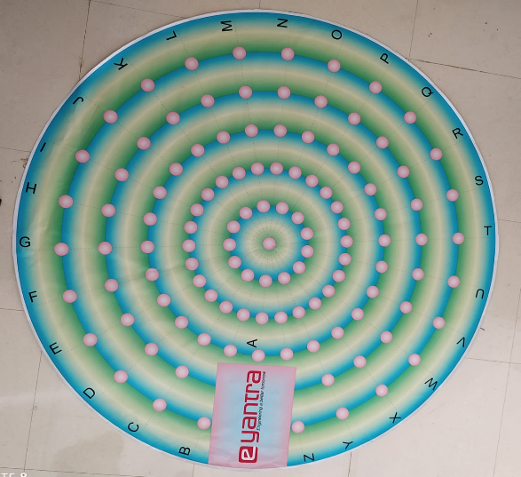
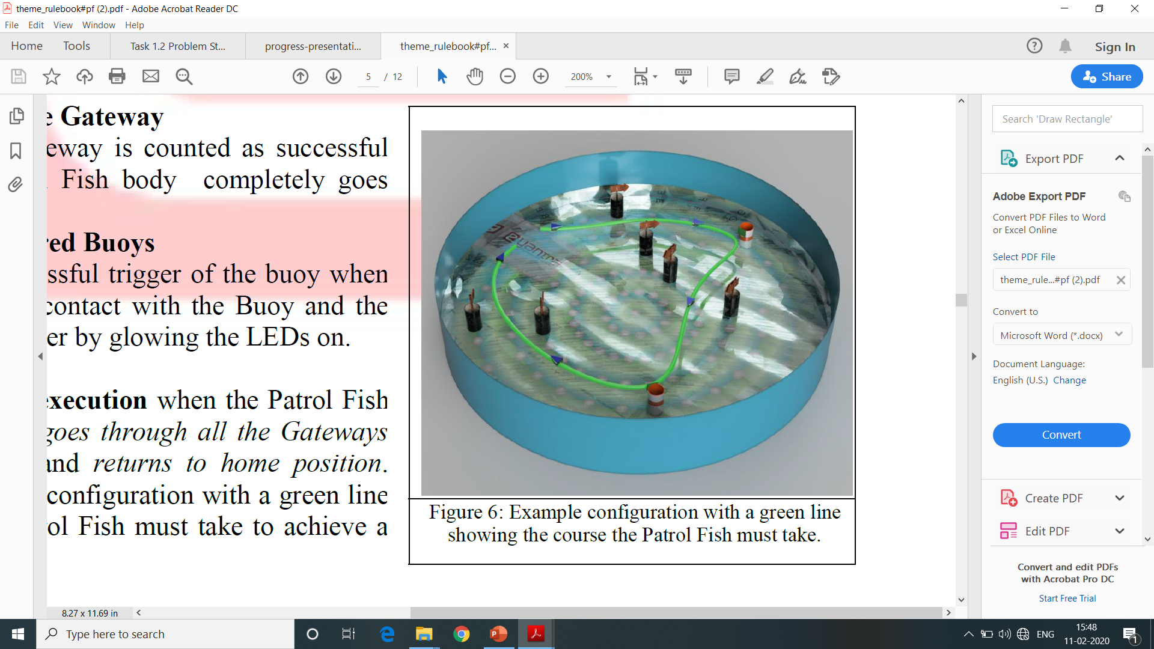
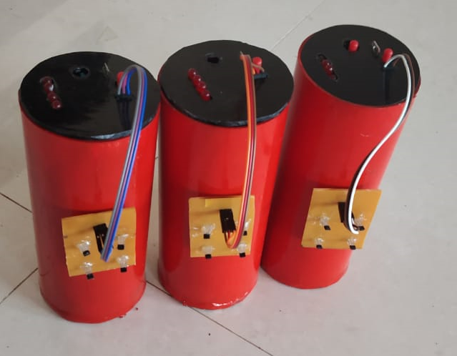
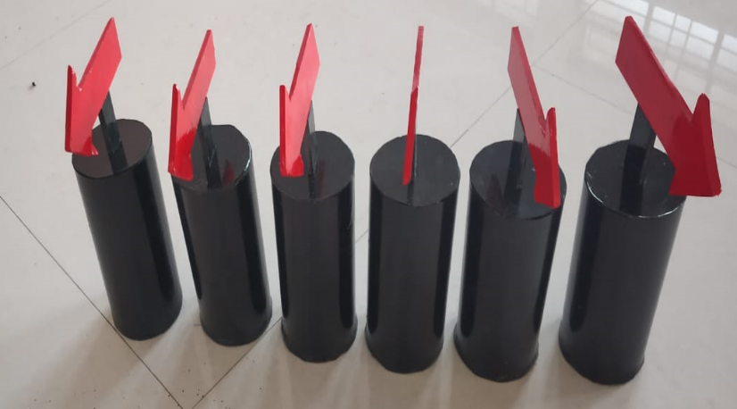
2. Arena Setup:
1.Arena
2.Pool
3.Gateway
4.Bouy

Slide 4
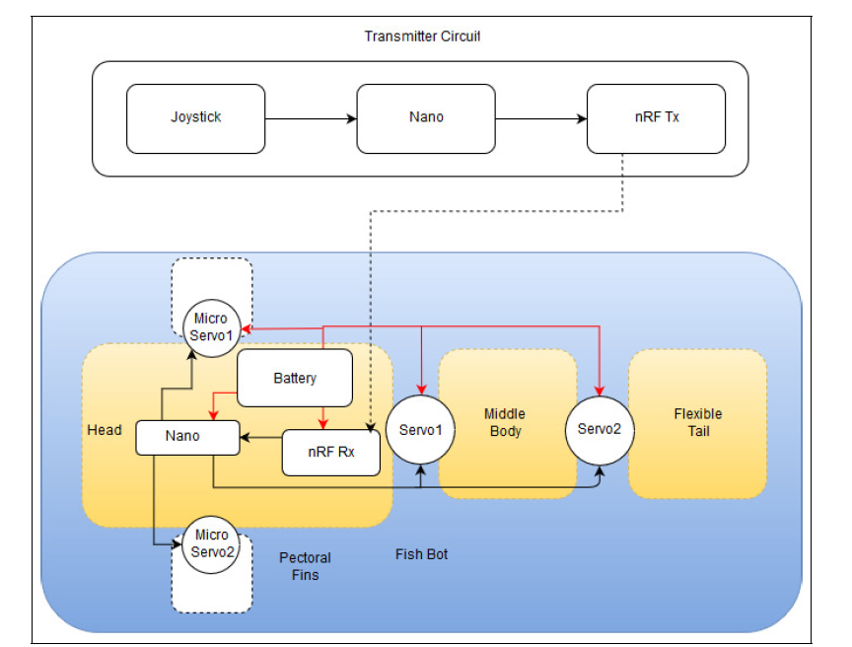
3.Block Diagram:
Receiver circuit

Slide 5
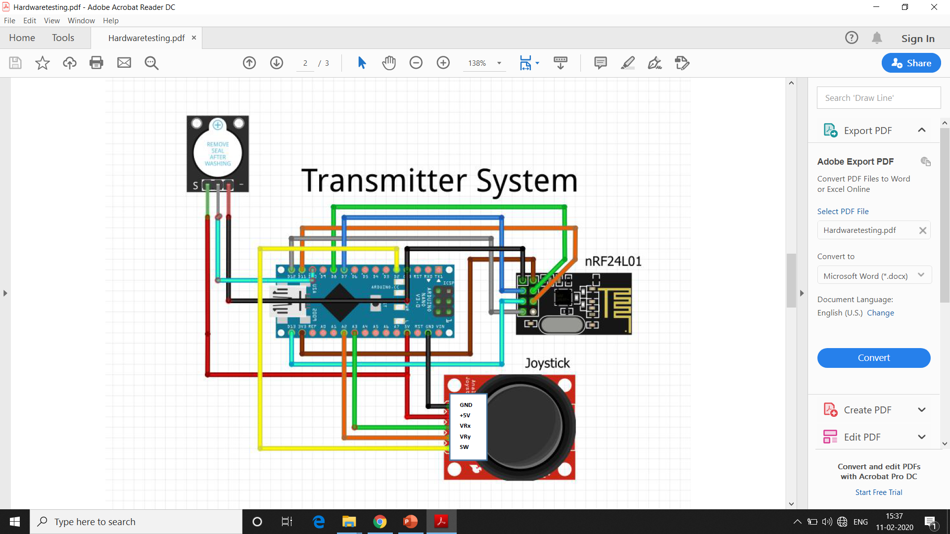
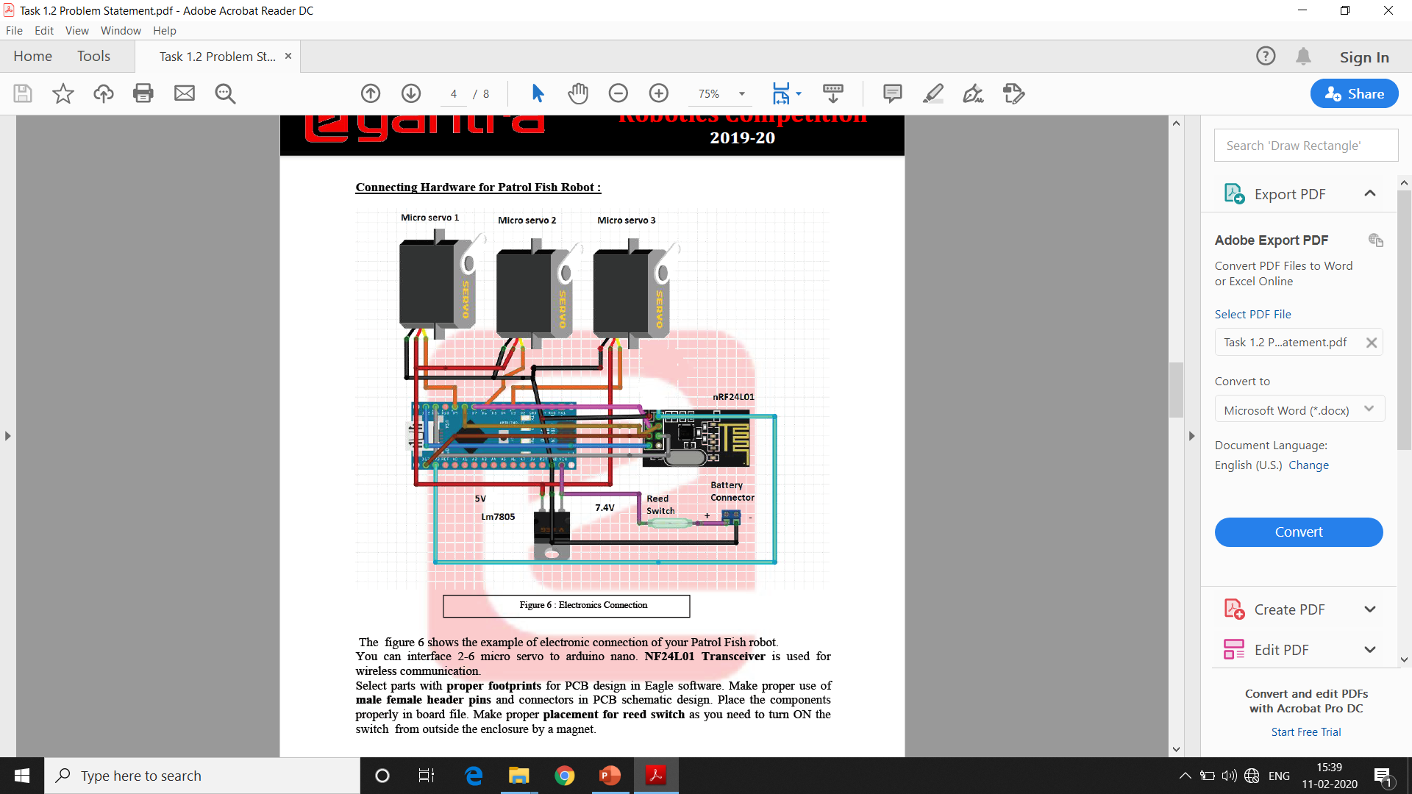
4.Connection diagram:
1.Transmitter System
2.Receiver System

Slide 6
5.Challenges:
3D designing and fabrication.
3D Animation using Blender Software.
3D Gaming using key controlled.
PCB designing and Fabrication.
Microcontroller programming
Wireless communication.
Waterproofing.
7.1 Waterproofing the Electronics:
✓ Nail Polish Coating
✓ Silicone Paste/Adhesive
7.2 Waterproofing of Fish:
✓ Custom Silicon Gasket using a 3D Printed Mould and Liquid Silicone Rubber.
✓ Candle Wax near the circular joints.
✓ Waterproof duct tape.

Slide 7
6.Hardware:
Components | Quantity
Arduino Nano(Atmega328 Controller) | 2
NRF24L01 | 2
Joystick Module | 1
Buzzer Module | 2
Servo Motors | 5
Batteries | 5, 9v
Reed Switch | 1
Slide Switch | 5
Magnet. | 2
Components | Quantity
Push Button | 10
Timer Ic555 | 3
Hall Effect Sensor | 27
LEDs | 20
Capacitors & Resistor | _
Copper Clad | _
Programming Cable | 2
IC7805,7809,7812 | 5
Jumper Wire | _
PLA 3D Printing Material | 1kg

Slide 8
7.Software:
1.Autodesk Fusion 360:- 3D designing.
2.Autodesk eagle :- PCB Designing.
3.Arduino IDE`:- Programing the microcontroller.
4.Blender :- 3D Animation.
5. Latex :- For Documentation.
6.UBGE :- 3D Game using key controlled.

Slide 9
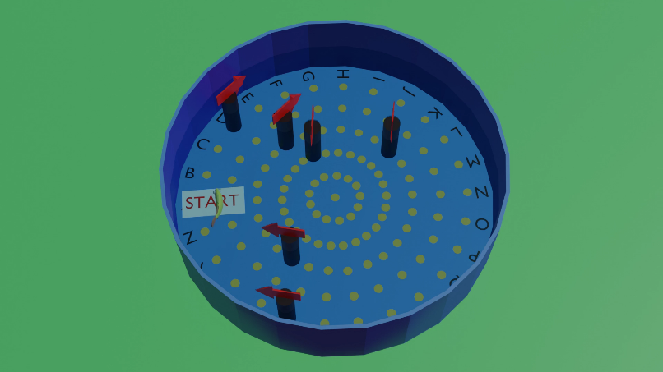
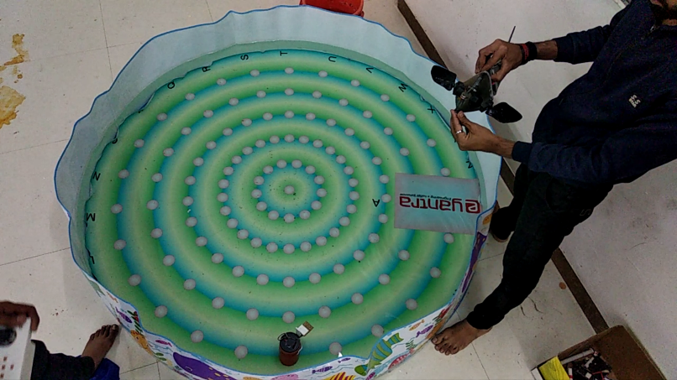
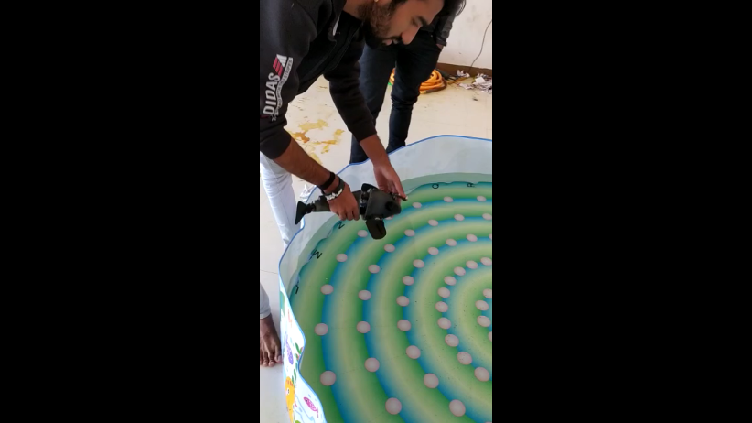
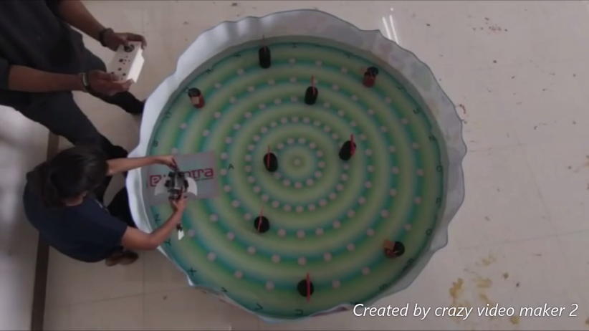
8. Videos:-
Video 1:Fish Animation in Pool.mp4 Video 3:- Progress_Video_2.mp4
https://youtu.be/NSARryXW1uk https://youtu.be/BRsX5pmcscM
Video 2: Progress_Video_1.mp4 Video 3:Final Demonstration
https://youtu.be/jCL4euYWsCw https://youtu.be/UlDN9iitq78

Slide 10
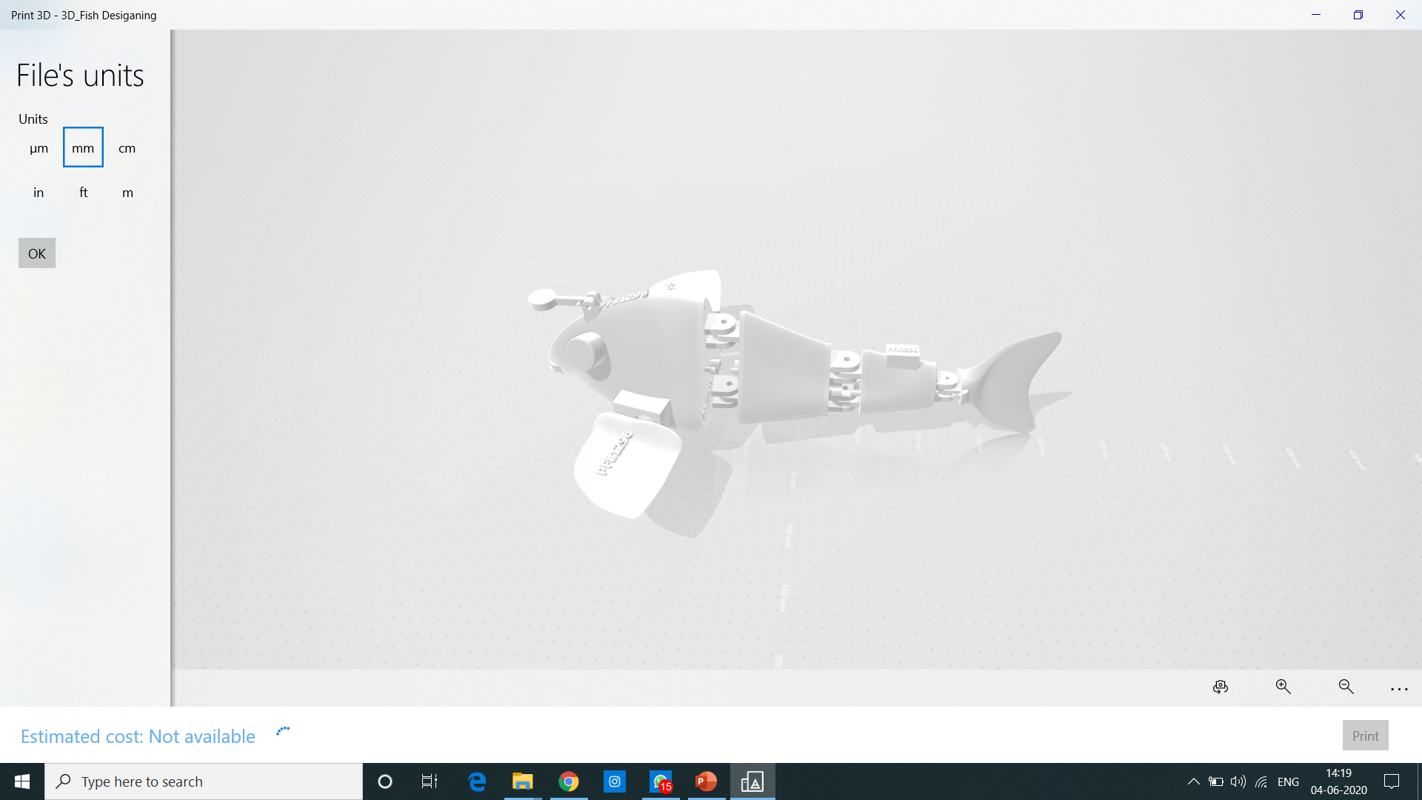
9. 3D Fish Design using Autodesk Fusion 360

Slide 11
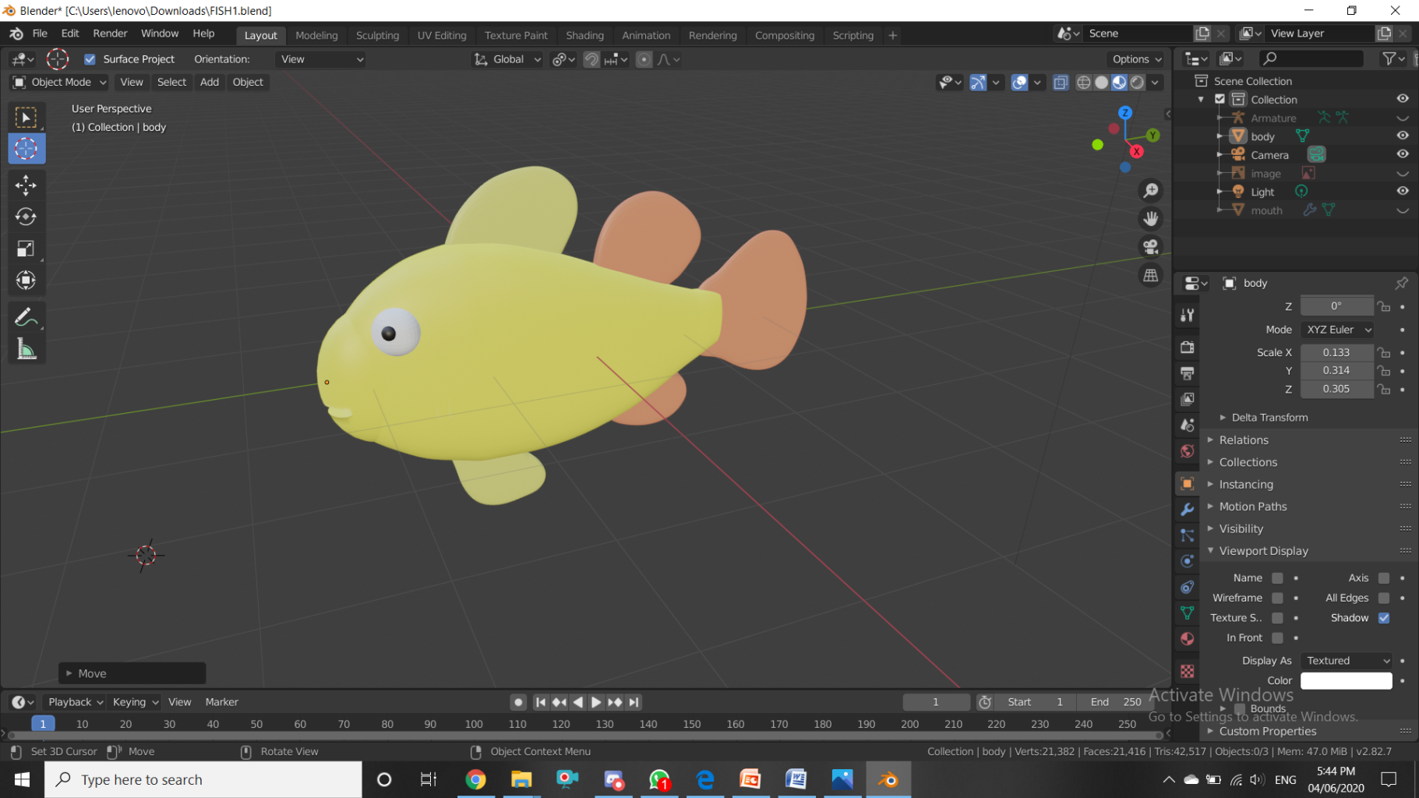
10. 3D Fish using Blender 2.82

Slide 12
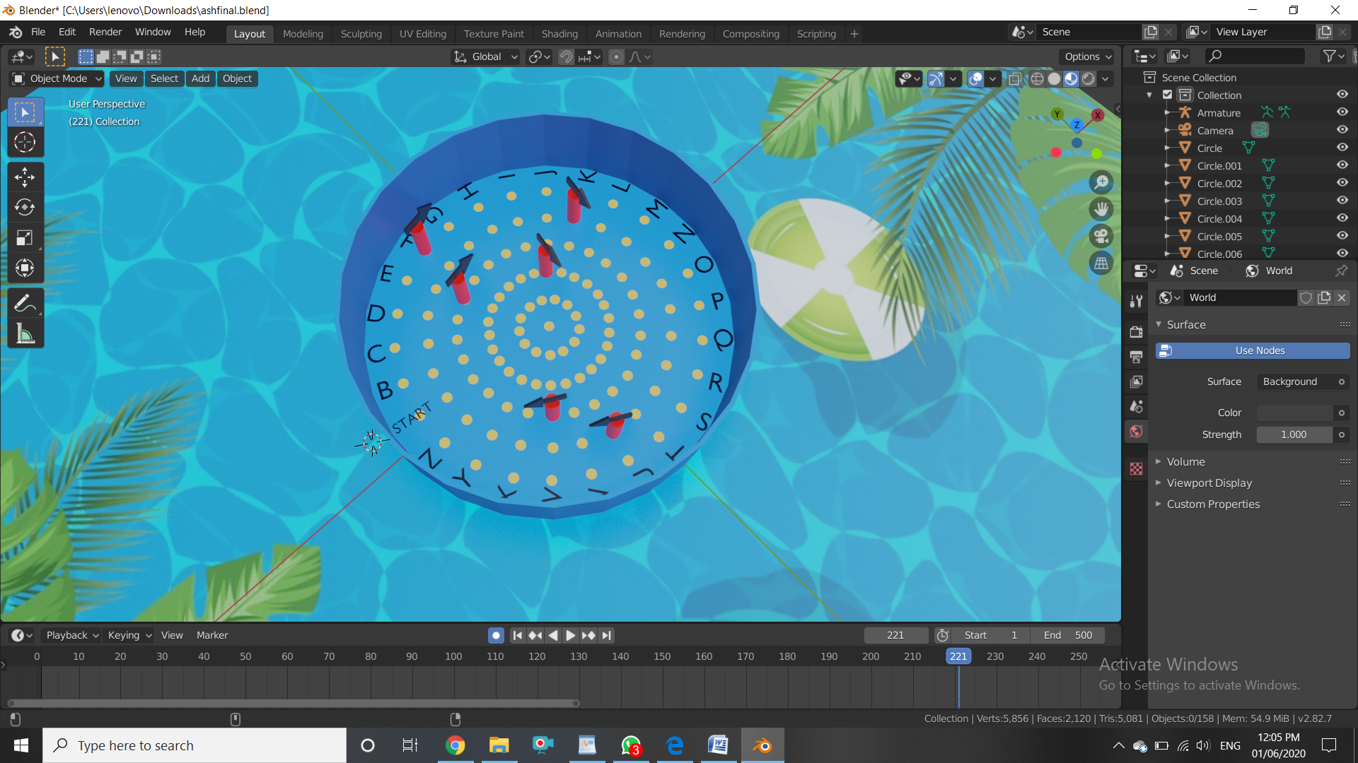
11. 3D Arena Design using Blender 2.82

Slide 13
10. Application:
1.Submarine wireless communication.
2.3D Game Design Platform.
3. Creating Animated movies.
4. Macrolevel Research on Aquatic life and habitat.

Slide 14
Thank you

